Slide 1
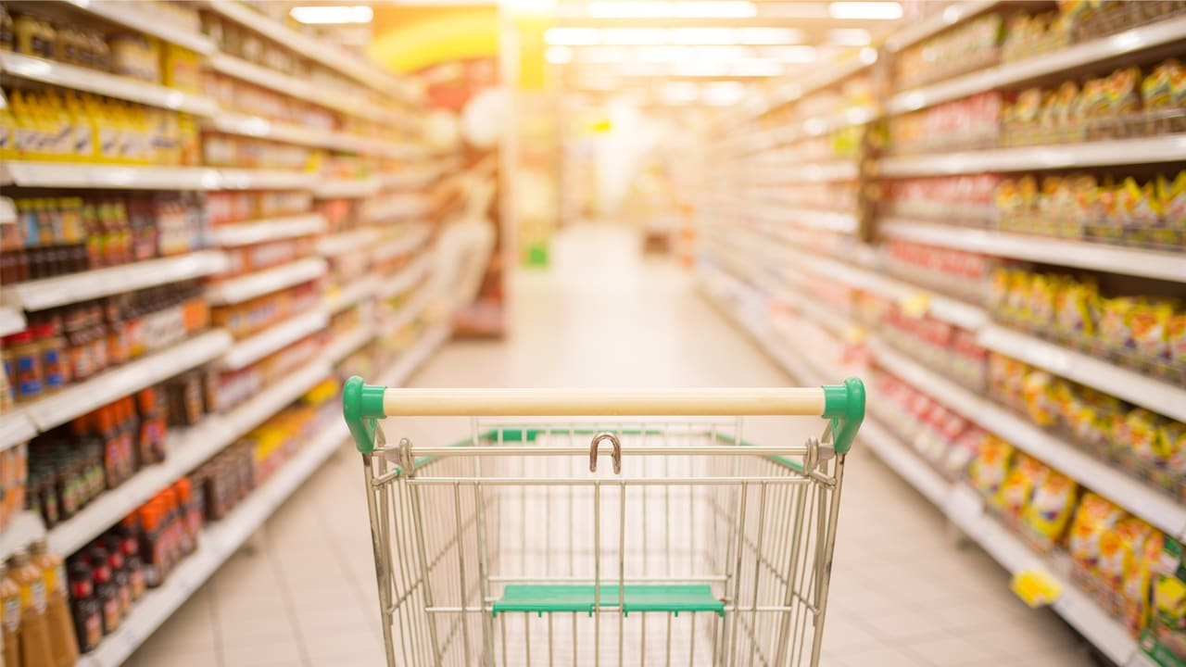
FMCG DATA ANALYSIS
Introduction:
The FMCG Analytics Dashboard: Unlocking Insights through Data Analysis
The FMCG industry's success hinges on informed decisions. Enter the FMCG Analytics Dashboard – a powerful tool designed to decode data for strategic advantage. This dashboard transforms raw information into actionable insights, guiding efficient operations, and fueling growth. By leveraging advanced analytics techniques, it unearths hidden patterns, forecasts trends, and illuminates customer behavior. This presentation unveils the pivotal role of data analysis in driving FMCG excellence. Join us to explore the journey from data collection to actionable insights and witness how the dashboard empowers businesses to thrive in a dynamic market landscape.

Slide 2

Summary
The dashboard contains data on the sales of FMCG products in different cities, states, and stores.
The data includes the brand name, date of sale, first/second purchase, fiscal year, key, lease start date, store code, sales type, state, store category, store open date, store closing date, store name, status, units sold, net amount, and number of records.
The data can be used to track the sales performance of different FMCG products, identify trends in sales, and make informed decisions about marketing and distribution.
For example, the data could be used to see which Area managers are selling the higher in different cities, or which stores are generating the most revenue.
The data could also be used to track the effectiveness of marketing campaigns or to identify new opportunities for growth.
Overall, the FMCG dashboard data is a valuable resource for businesses that sell FMCG products.

Slide 3
Objectives
Enhance Decision-Making: Enable stakeholders to make informed and strategic decisions based on data-driven insights.
Improve Operational Efficiency: Streamline processes, optimize resources, and reduce inefficiencies through data-backed recommendations.
Identify Market Trends: Uncover emerging market trends and consumer preferences to capitalize on new opportunities.
Geographical Performance Analysis: Identify growth potential and improvement areas in city-wise and state-wise sales.
Personalize Marketing: Segment customers based on behavior and preferences for targeted marketing campaigns.
Enhance Customer Experience: Use data insights to enhance customer satisfaction and loyalty by understanding their preferences and needs.
Sales Strategy Optimization: Enhance sales strategies based on analysis of sales types, meal categories, and store locations.
Sales Growth Enhancement: Identify factors contributing to sales growth and develop strategies.

Slide 4
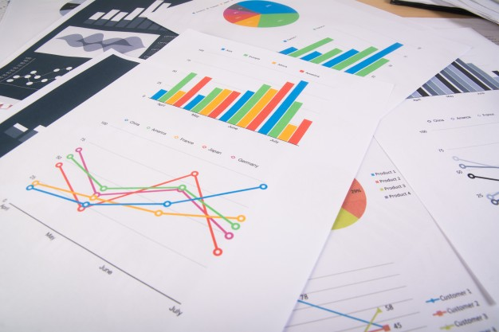
FMCG KPI
Total sales
Sales type
Meal wise sales
Store wise sales
City wise sales
State wise sales
Monthly sales trend
AM wise sales

Slide 5
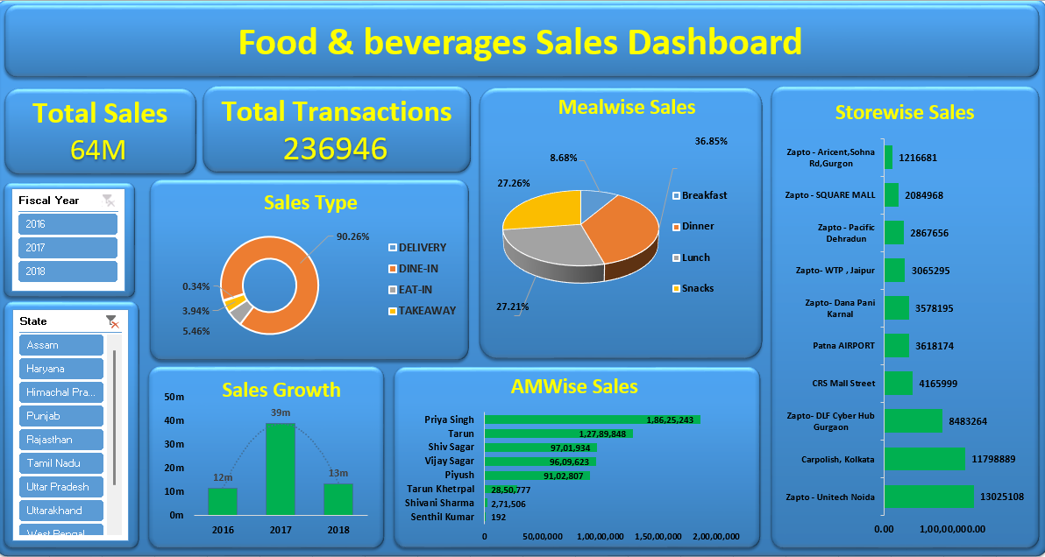
Excel Dashboard

Slide 6
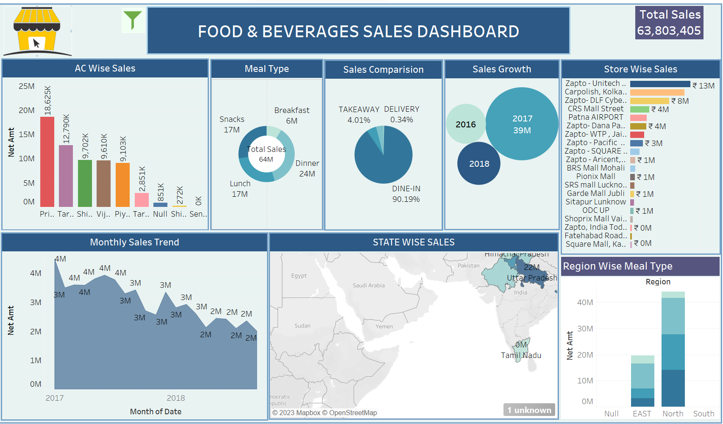
Tableu Dashboard

Slide 7
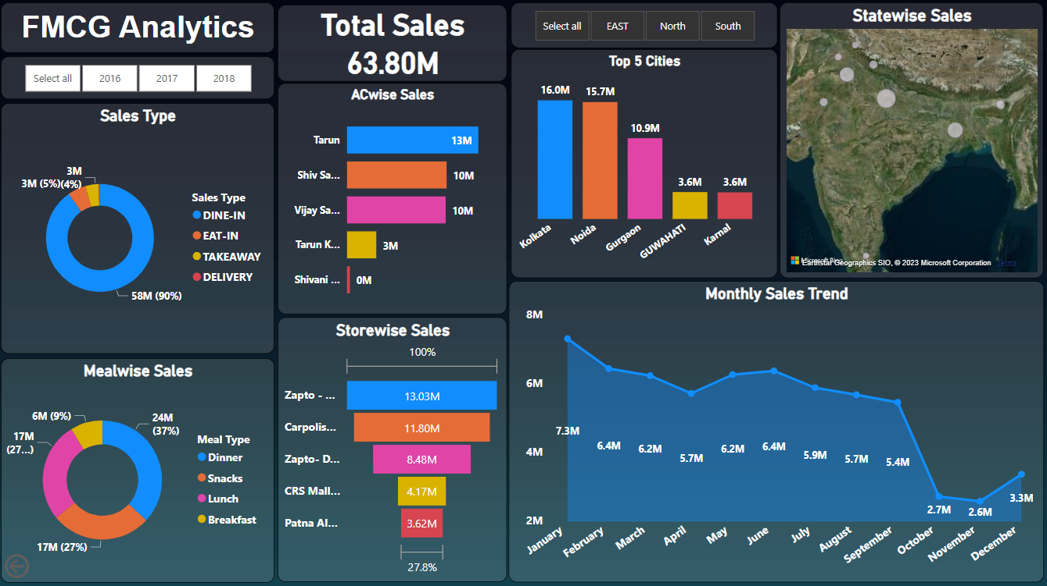
PowerBI Dasboard

Slide 8
Key Insights
Total Dashboard Sales: The cumulative sales figure displayed on the dashboard is $63.80 million.
2016 Sales Insight: Despite the apparent low total sales of $12 million in 2016, it's essential to consider that this data is based on only 3 months of sales. If we had a complete 12 months of data, the actual total sales would likely be significantly higher.
2017 Sales Performance: The total sales of $39 million in 2017 is noteworthy, especially considering that we have data for all 12 months of that year.
2018 Sales Analysis: The reported sales of $13 million in 2018 encompass only 6 months of data.
Data Comparison Consideration: It's important to recognize that comparing the sales data for 2016 and 2018 directly isn't straightforward due to the differing data availability (3 months vs. 6 months). Adjusting for this data discrepancy, the 2018 sales performance appears favorable, yet there's potential for enhancement.
Monthly Sales Trends: Our analysis of monthly sales trends reveals noteworthy patterns for the years 2016, 2017, and 2018. In 2016, the pinnacle of sales occurred in January, totaling 4.48 million. The year 2017 saw its peak in June, generating sales of 3.93 million. Similarly, in 2018, the highest sales were achieved in May, reaching a value of 2.44 million.

Slide 9
Sales Breakdown by Type: Our analysis underscores the prominence of dine-in sales during dinner hours, outpacing other categories across various states, cities, and stores. Dine-in remarkably captures over 90% of the total sales. To optimize further, consider exploring strategies to bolster eat-in and take-away sales, which currently stand at 5% and 4% respectively. Additionally, optimizing delivery services could potentially enhance its share of sales, currently at 1%.
Recommendations:
Streamline Take-Away Process: Simplify the take-away process by offering convenient online ordering and swift pickups. Ensuring orders are ready on time and packaged well can encourage more customers to choose this option.
Expand Delivery Network: Invest in optimizing your delivery services. Expanding the delivery coverage area, ensuring timely deliveries, and maintaining food quality during transit can increase customer satisfaction and sales.
Menu Diversity: Craft a diverse menu that appeals to different preferences for each sales category. Offering unique dishes or meal deals exclusively for dine-in, eat-in, take-away, and delivery can cater to varied customer needs.
Engage with Loyalty Programs: Introduce loyalty programs that provide incentives for repeat customers across all sales categories. This approach can stimulate customer loyalty and encourage them to explore different options.

Slide 10
Distribution of Sales by Meal Type: Among the four meal categories—dinner, snacks, lunch, and breakfast—the most prominent is dinner, accounting for nearly 37% of total sales. Both snacks and lunch contribute equally at 54%, while breakfast holds a 9% share. Consider further exploring strategies to enhance breakfast sales, which currently have relatively lower significance.
Recommendations:
Targeted Promotions: Design special promotions or offers that focus on breakfast items to attract more customers during the morning hours. Highlight the unique value of breakfast offerings.
Combo Deals: Create breakfast combo deals that offer a variety of items at a discounted price. This encourages customers to try different breakfast options and may lead to increased sales.
Extended Hours: Consider extending breakfast service hours to capture a wider audience. Cater to both early risers and those who prefer a slightly later breakfast.
Collaborations: Partner with local businesses, gyms, or wellness centers to promote breakfast as an integral part of a healthy lifestyle.
Healthy Breakfast Choices: Capitalize on the growing trend of health-conscious consumers by offering nutritious and customizable breakfast options. Include fresh fruit, yogurt, and whole-grain choices.
Customer Feedback: Gather feedback from existing customers to understand their preferences and areas for improvement in the breakfast menu. Implement changes based on their input.

Slide 11
Store-Specific Sales Analysis: Among the stores evaluated, Unitech Noida, Carpolish, and DLF Cyber Hub Gurgaon emerge as the top 3 performers. Their remarkable consistency in surpassing sales targets has significantly propelled the company's growth trajectory.
On the flip side, Siemens Office -1 Gurgaon, Waves Mall Ludhiana, and Trichy Airport demonstrate comparatively lower performance. A strategic approach to enhancing sales efforts could notably benefit these stores and contribute to overall improvements.
Recommendations
Analyze the top-performing stores: Conduct an in-depth analysis of Unitech Noida, Carpolish, and DLF Cyber Hub Gurgaon to identify the factors contributing to their success. This analysis can help to replicate their strategies in other stores and improve overall performance.
Identify the reasons for low performance: Identify the reasons for the comparatively lower performance of Siemens Office -1 Gurgaon, Waves Mall Ludhiana, and Trichy Airport. This analysis can help to identify the root cause of the issue and develop strategies to address it.
Store Visits and Feedback: Conduct regular store visits to monitor the sales performance of lower-performing stores and provide feedback and coaching to help them improve.
Visual Merchandising: Enhance the visual appeal of products and displays in low-performing stores. Eye-catching displays can attract more customers.
Collaborations: Forge partnerships with nearby businesses or events to drive more foot traffic to the stores. Collaborative promotions and cross-promotions can create synergistic benefits.

Slide 12
Sales Distribution Across States: Our analysis reveals distinct patterns in sales timings across states. Notably, Assam, Haryana, and Himachal Pradesh exhibit peak sales during lunch hours. Conversely, the remaining states witness higher sales volumes during dinner time. It's worth considering cultural nuances as a potential factor influencing these variations in eating habits.
Recommendations
Promotional Strategies: Create lunchtime promotions and discounts exclusive to Assam, Haryana, and Himachal Pradesh. Incentivize customers to choose your store for their midday meals.
Customized Timing: Tailor store operating hours in Assam, Haryana, and Himachal Pradesh to capitalize on lunchtime peak sales. Adjust schedules to align with local preferences.
Cultural Awareness: Train staff to understand and appreciate local dining habits and cultural nuances. Provide personalized service that reflects these preferences.
Menu Personalization: Offer customizable lunch options that allow customers to tailor their meals according to their preferences, catering to diverse tastes.
Customer Feedback: Seek input from customers in each state to understand their dining preferences and expectations. Adapt your offerings accordingly.
Continuous Analysis: Regularly monitor sales trends in these states to identify shifts in preferences. Adapt your strategies based on changing customer behaviors.

Slide 13
Top Performers AM’s Analysis: Our examination of the sales data indicates that Priya Singh, Tarun, and Shiv Sagar have consistently showcased outstanding performance, securing their positions among the top 3 overall performers. Their persistent success in surpassing sales targets has played a pivotal role in propelling our company's growth trajectory.
Recommendations
Top Performers Recognition: Acknowledge the exceptional contributions of Priya Singh, Tarun, and Shiv Sagar publicly. Celebrate their achievements as role models for the team, fostering a culture of healthy competition.
Best Practices Sharing: Encourage Priya Singh, Tarun, and Shiv Sagar to share their strategies and techniques with the wider team. This knowledge exchange can inspire others to elevate their performance.
Performance Improvement Plan: Develop a structured improvement plan for Senthil Kumar, setting clear goals and milestones. Regularly review progress to track his advancements.
Collaborative Projects: Encourage cross-functional collaboration between Senthil Kumar and high-performing colleagues. Exposure to successful strategies and teamwork can positively influence his approach.
Enhancing Non-Performing AM's Impact: Senthil Kumar's performance falls below expectations. To address this, it's recommended to provide him with targeted training and resources. Alternatively, considering reassigning or reallocating responsibilities could optimize his contributions to the business. This proactive approach could potentially unlock untapped potential and contribute positively to the team's overall achievements.

Slide 14
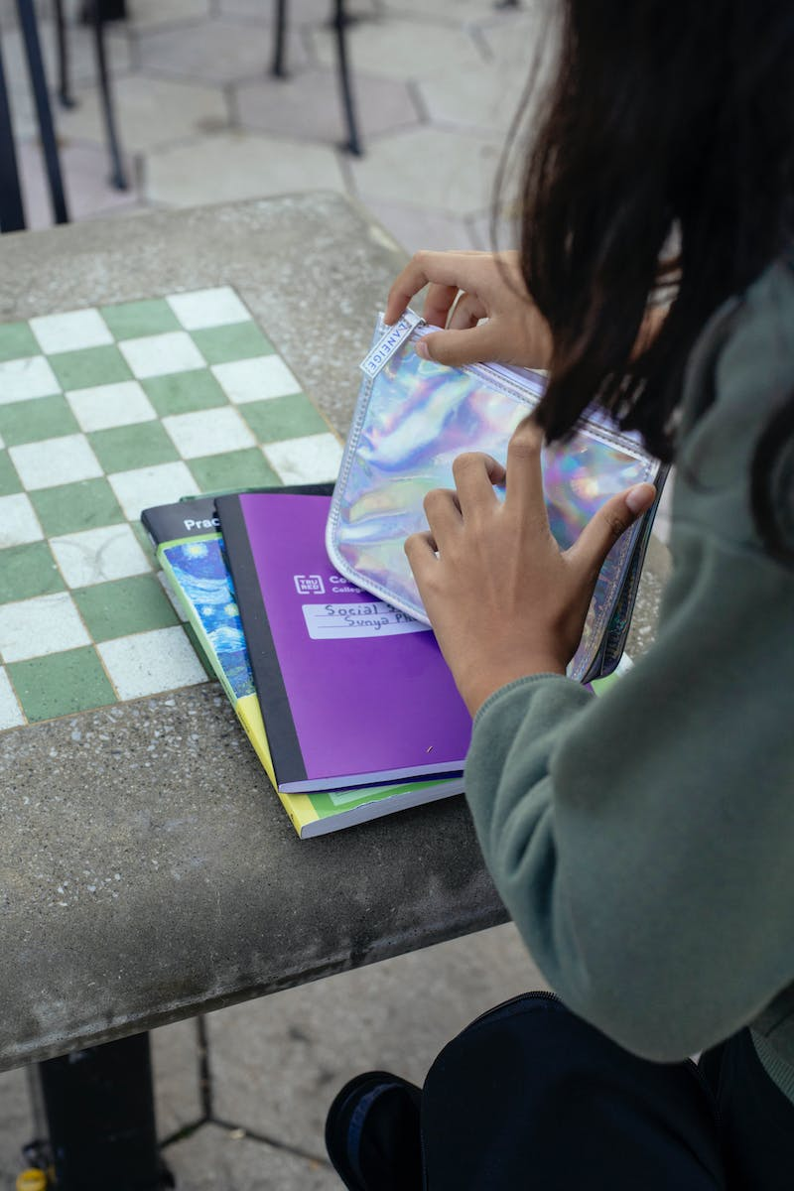
Conclusion
The FMCG dashboard data serves as a cornerstone for strategic decision-making, operational excellence, and trend analysis. It unveils dynamic sales trends over the years, with 2017 as a standout due to complete sales data. The dominance of dine-in sales prompts an exploration of untapped potential in eat-in, take-away, and delivery categories, achievable through streamlined processes and an expanded delivery network. The strategic enrichment of the breakfast segment through diverse menus and partnerships offers growth avenues. Individual store analyses spotlight top performers while guiding the transformation of underperforming ones through visual merchandising and collaborations. Geographical variations in sales patterns advocate for tailored promotions and cultural sensitivity. Acknowledging high-performing Area Managers, fostering knowledge sharing, and cultivating improvement plans collectively amplify team achievements. Ultimately, the comprehensive data insights form the bedrock for strategic expansion and an elevated customer journey.

